Slide 1


Movie Ticket Booking Web App
Submitted by: Sudharsan Vishvak
Submission type : Individual
Batch :Axis Fintech Batch 12
Program :Axis FinTech Full Stack Development program
Date: 25/05/2023

Slide 2

Table of contents
INTRODUCTION
PROJECT DESCRIPTION
ARCHITECTURE
SPRING
MONOLITHIC
REACT JS
MySQL
UML CLASS DIAGRAM
SEQUENCE DIAGRAM
USE CASE DIAGRAM
OUTPUTS
CONCLUSION

Slide 3
Project Overview
The project aims to develop an online movie ticket booking system website for customers.
The system allows customers to book movie tickets online, saving time and reducing effort.
Customers can access the system from anywhere and at any time, as it is available 24/7.
The application provides ticket reservation services for various movies.
The online ticket reservation system offers a website for a cinema hall accessible to any internet user.

Slide 4
Functionalities
Functionalities:
Login And Logout
View Movies
Watch Trailer
Book Movie Ticket
Add Review
View Shows,Theaters & Movies List from database

Slide 5
Back-end Development
Spring Boot Architecture:
Description:
The Client makes an HTTP request (GET, PUT, POST, etc.)
The HTTP request is forwarded to the Controller. The controller maps the request. It
Processes the handles and calls the server logic.
The business logic is performed in the Service layer. The spring boot performs all the
Logic over the data of the database which is mapped to the spring boot model class through java persistence library (JPA).
Finally We get the Response from the controller.
Dependencies:
Spring Boot Devtool
Spring web
Spring Data jpa
MySQL Driver
Lombok

Slide 6
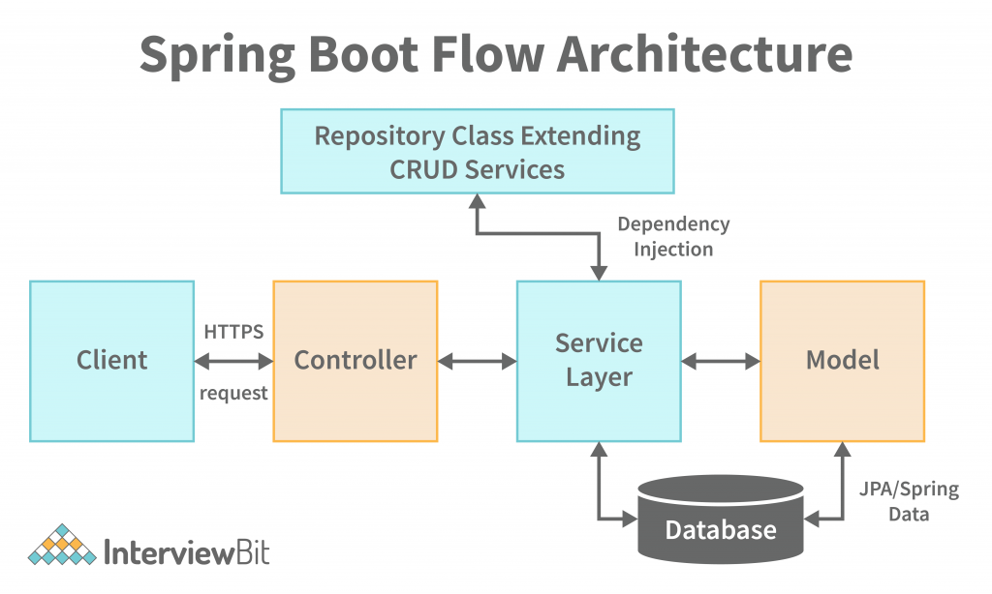

Slide 7
Monolithic Architectures:
In Spring Boot, a monolithic architecture refers to an application design where all the components and functionality are bundled together as a single unit.
In a monolithic architecture, the entire application is deployed as a single artifact, making it easier to develop, test, and deploy.
All the modules and features of the application are tightly coupled and share the same codebase, database, and runtime environment.
Monolithic applications in Spring Boot are often easier to develop initially as they have a simpler structure and require less setup and configuration.

Slide 8
Front End Development
ReactJS
ReactJS is a JavaScript library for building user interfaces.
It follows a component-based architecture.
ReactJS utilizes a virtual DOM for efficient rendering and updating of components.
It promotes a declarative approach to building UI based on the current state.
ReactJS has a large and active community with extensive documentation.
It offers a rich ecosystem of third-party libraries and tools.
ReactJS is widely used for developing modern web applications.
Axios js
Axios is a widely used JavaScript library for making HTTP requests in the browser. It provides an easy-to-use API that supports various request methods such as GET, POST, PUT, DELETE, etc.

Slide 9
Database
MySQL
MySQL is a popular open-source relational database management system (RDBMS) that is widely used for storing and managing structured data.
It offers a robust and scalable solution for handling large amounts of data efficiently. MySQL can handle high-traffic websites and applications with ease.
MySQL supports various operating systems such as Windows, macOS, Linux, and Unix. It also provides language bindings for different programming languages, including C, C++, Java, Python, and more.
MySQL supports standard SQL (Structured Query Language), allowing users to interact with the database using queries. It provides a wide range of SQL features, including data manipulation, data definition, data control, and transaction management.

Slide 10
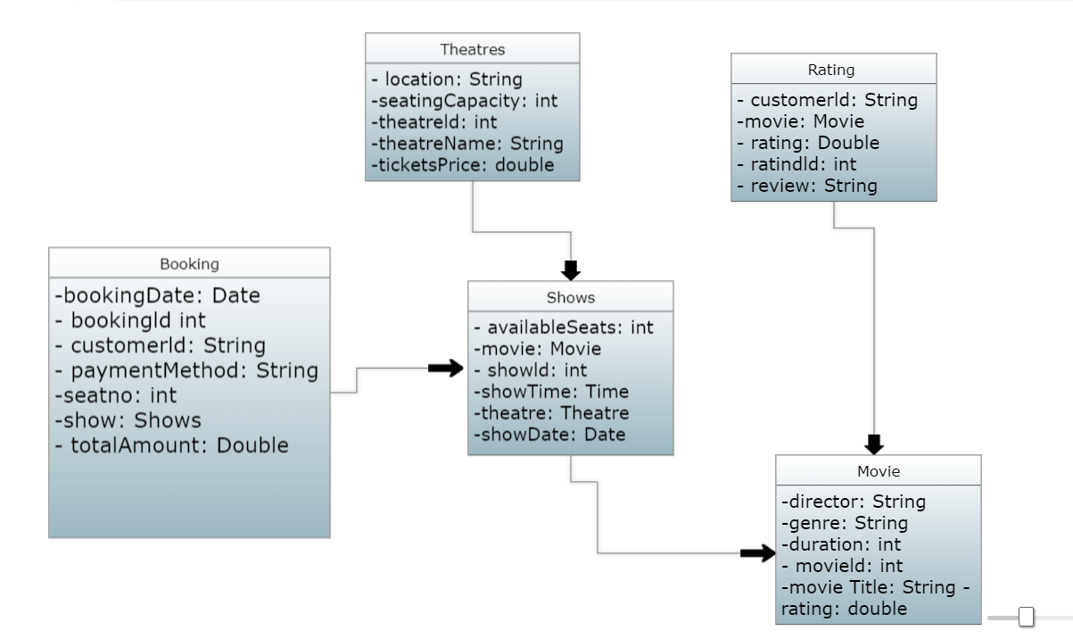
UML Class Diagram

Slide 11
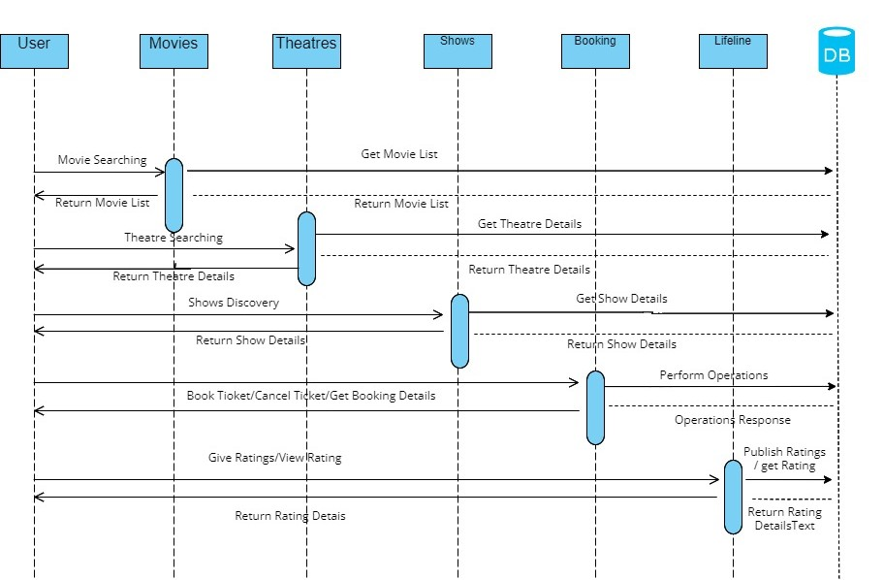
Sequence Diagram

Slide 12
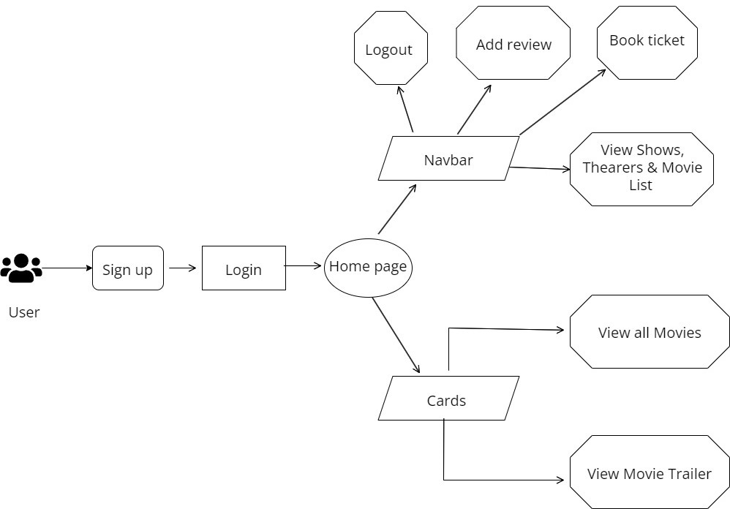
UseCase Diagram

Slide 13
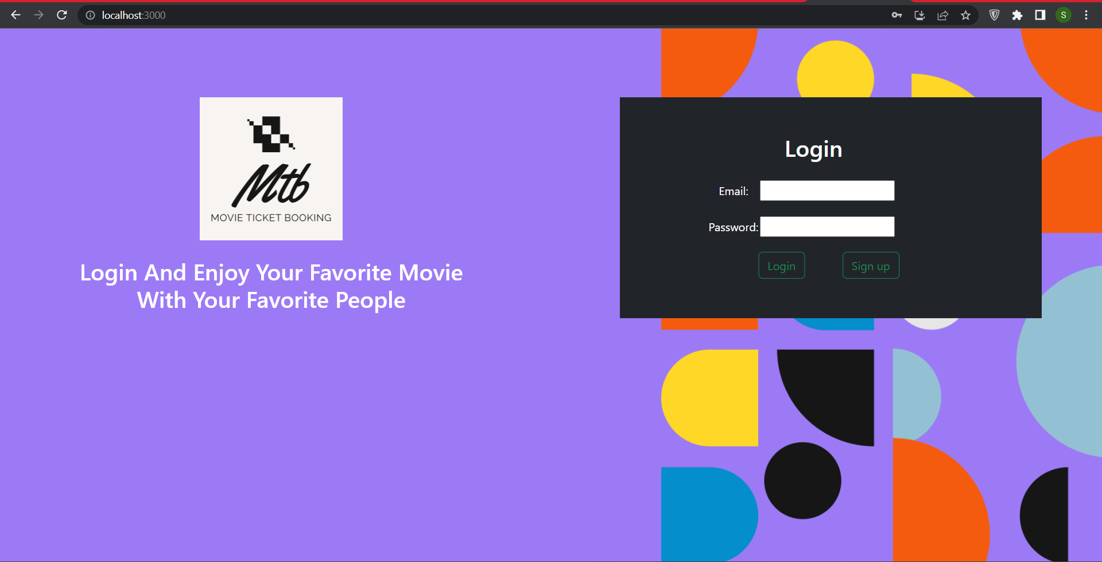

Slide 14
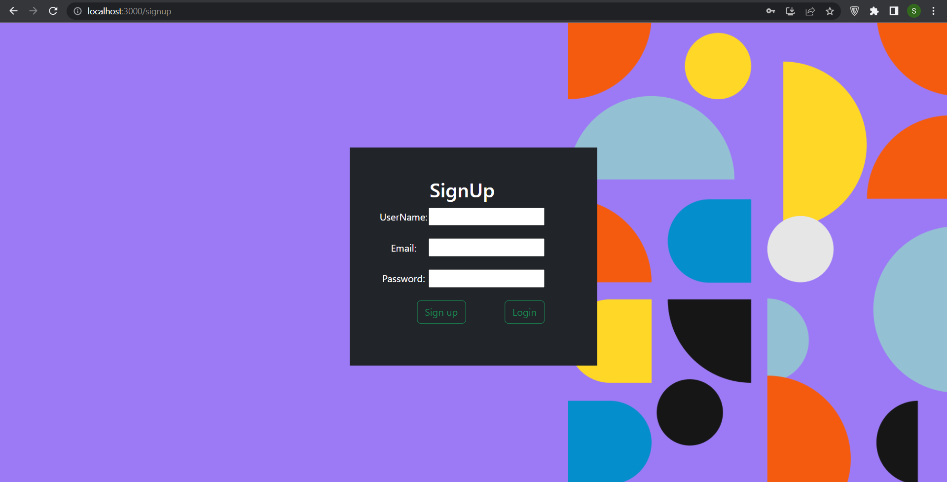

Slide 15
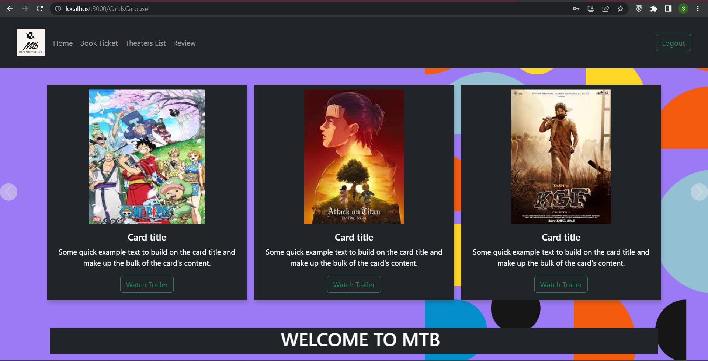

Slide 16
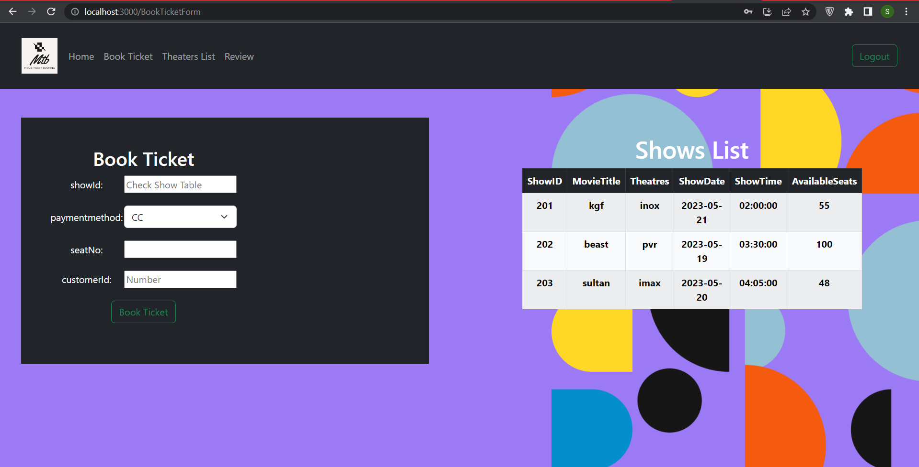

Slide 17
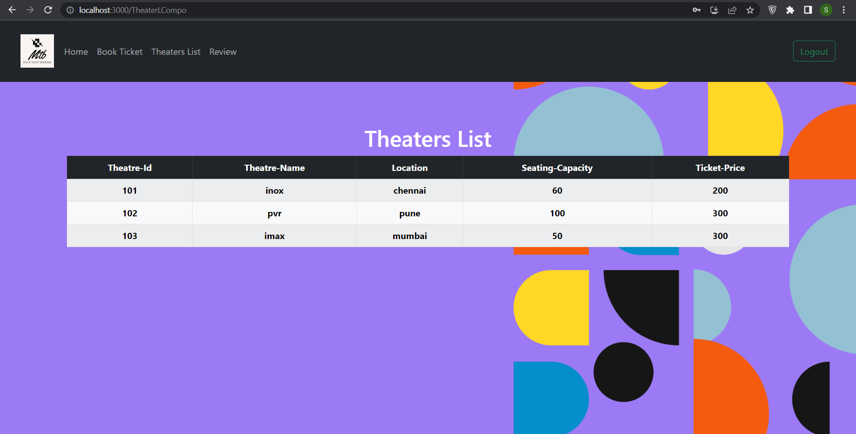

Slide 18
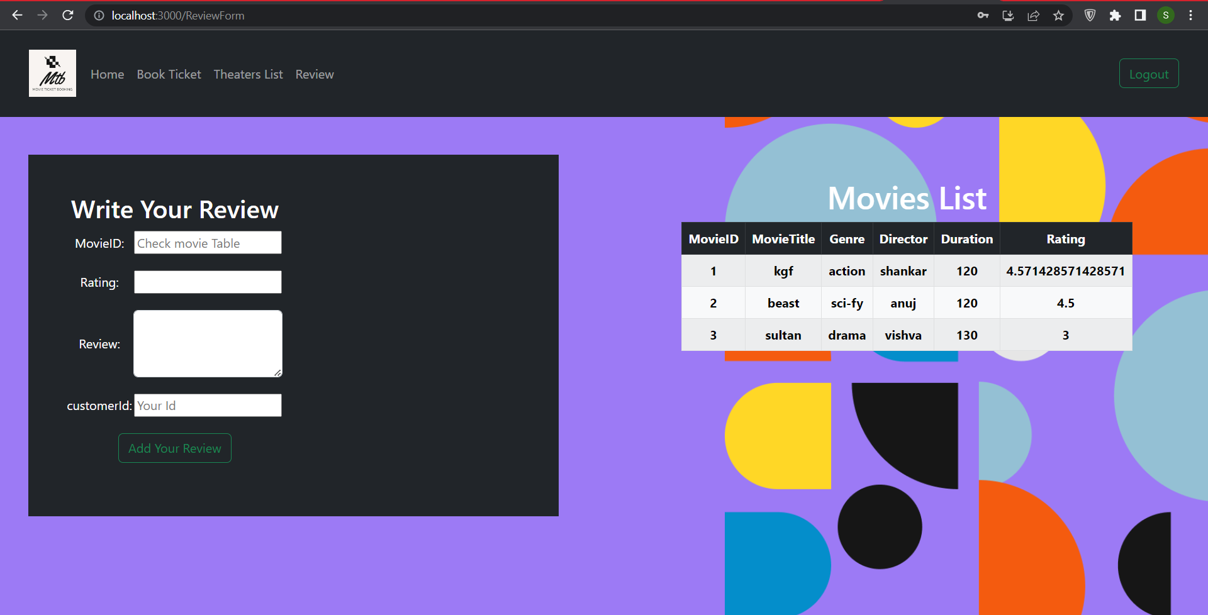

Slide 19
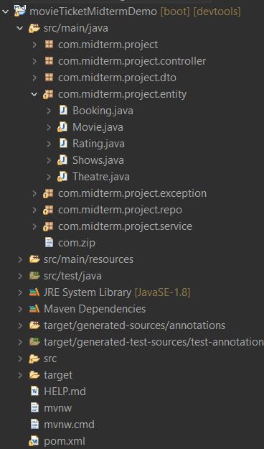
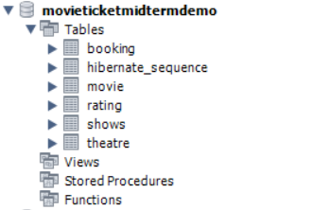
Database and the tables from MySQL Workbench
Spring boot project from eclipse

Slide 20
Future Works
Future Work
Payment method gateway
Search bar Where You can search movies,theaters or shows as a user
Proper Admin and User Roles, adding and deleting movies ,theatres and shows will be available in the admin role

Slide 21
Conclusion
The Movie Ticket Booking Application is an essential requirement for moviegoers to book their movie tickets easily and efficiently.
Thank you

